Slide 1
PPI Mode2
Hardware/Software
Example

Slide 2
Treating Even and Odd Ports
Odd Port
Even Port
CS1
CS1
CS1
CS2
CS2
Decoder
Decoder

Slide 3
8-bit data from Even Port
Odd Port
Even Port
CS1
CS1
CS1
=1
= 0
CS2
CS2
Decoder
Decoder
MOV DX,4000H
IN AL,[DX]
IN AL , 40H

Slide 4
8-bit Data from Odd Port
Odd Port
Even Port
CS1
CS1
CS1
= 0
=1
CS2
CS2
Decoder
Decoder
MOV DX,4001H
IN AL , DX
IN AL , 41H

Slide 5
16-bit Data Access from Even Port
Odd Port
Even Port
CS1
CS1
CS1
= 0
= 0
CS2
CS2
Decoder
Decoder
MOV DX,4000H
IN AX , DX

Slide 6
16-bit Data Access from Odd Port
First Process
Second Process
Odd Port
Even Port
Odd Port
Even Port
CS1
CS1
CS1
CS1
CS1
CS1
=0
=1
=1
=0
CS2
CS2
CS2
CS2
Decoder
Decoder
Decoder
Decoder
MOV DX,4001H
IN AX , DX

Slide 7
Address Decoding for the Peripherals
Buffer
D0-D7
8255A
PPI
8086
Latch (‘373)
A0
A1
A2
A3
A4
A5
A6
A7
Y0
Y1
Y2
Y3
Y4
Y5
Y6
Y7
A0
A1
INTRA
INTRB
AD0-AD7
X0
X1
X2
Decoder
CS
INTR
ALE
PPI Address: 011XXPP0

Slide 8
Port Addresses
PORTA EQU 01100000b
PORTB EQU 01100010b
PORTC EQU 01100100b
PPICOM EQU 01100110b
PPI Address: 011XXPP0

Slide 9
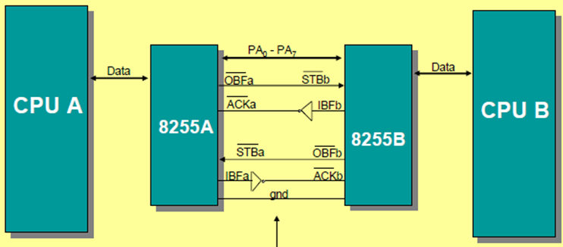
PPI Mode2
INTR
INTR

Slide 10
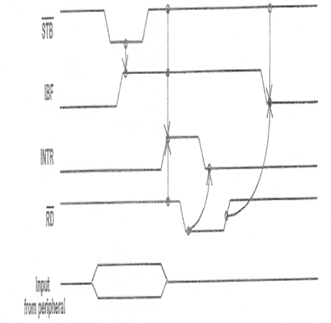
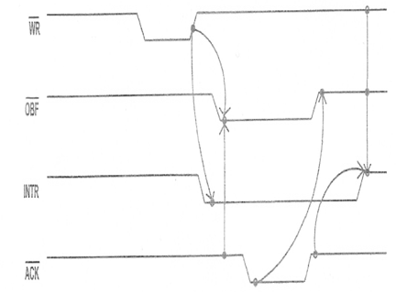
Send Receive Sequences WR TO PPI_A
PPI_A
PPI_B

Slide 11
Send Receive Sequences WR Complete
PPI_A
PPI_B
OBF Active
INTR inactive
STB Active

Slide 12
Send Receive Sequences IBF Active
PPI_A
PPI_B
ACK Active
IBF Active

Slide 13
Send Receive Sequences Data Available Now
PPI_A
PPI_B
Data Out Available
Data Available for IN

Slide 14
Send Receive Sequences OBF inactive
PPI_A
PPI_B
OBF inactive
STB Complete

Slide 15
Send Receive Sequences INT PPI_B Happens
PPI_A
PPI_B
INTR Active
Wait for ACK to be Completed

Slide 16
Send Receive Sequences INT PPI_B Process = RD data
PPI_A
PPI_B
INTR Active
Wait for ACK to be Completed

Slide 17
Send Receive Sequences RD Complete
PPI_A
PPI_B
INTR inactive
IBF inactive
ACK Complete

Slide 18
Send Receive Sequences INTR PPI_A Happens
PPI_A
PPI_B
INTR Active

Slide 19
Data Storage Policy
TX_FIFO
Process
PPI
RX_FIFO

Slide 20
FIFO Structure
Start of FIFO
Tail
Head
End of FIFO
Writing Data on Head
Reading Data from Tail
256 bytes FIFO
Is Assumed

Slide 21
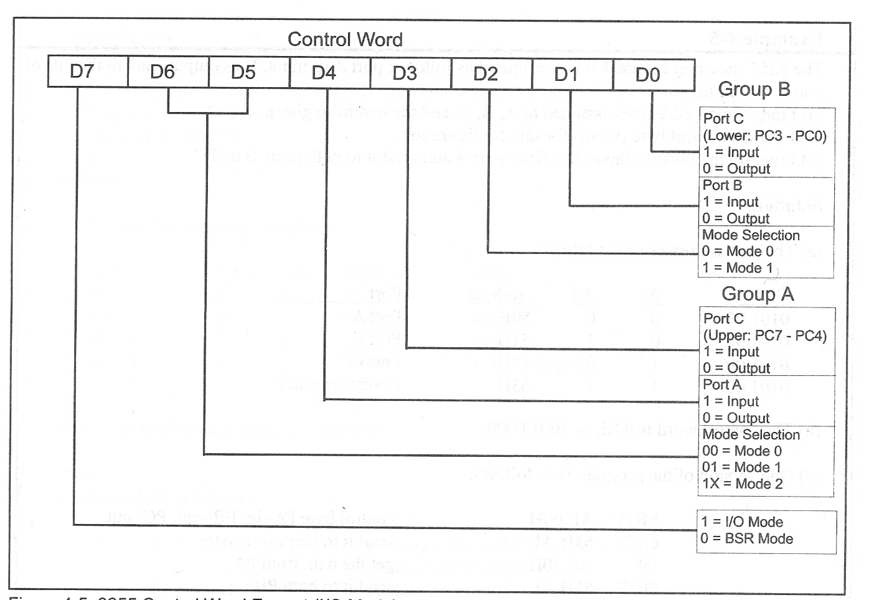
Initializing PPI
INIT_PPI:
MOV AL , 40H ;01XXXXXX Selecting Mode 2
OUT PPICOM , AL
MOV AL,1
MOV [TX_FLAG] , AL ; Flag Indicating Empty Buffer
XOR AL , AL
MOV [RX_FLAG] , AL ; Flag Indicating Empty Buffer
MOV [TX_head],AL
MOV [RX_head],AL
MOV [TX_tail],AL
MOV [RX_tail],AL
RET

Slide 22
Checking TX_FIFO
TX_AVAIL_SIZE:
MOV AL,[TX_head]
MOV BL,[TX_tail]
SUB AL,BL
RET
TX_EMPTY_SIZE:
MOV AL,[TX_head]
MOV BL,[TX_tail]
SUB AL,BL
NOT AL
RET

Slide 23
Checking RX_FIFO
RX_AVAIL_SIZE:
MOV AL,[RX_head]
MOV BL,[RX_tail]
SUB AL,BL
RET
RX_EMPTY_SIZE:
MOV AL,[RX_head]
MOV BL,[RX_tail]
SUB AL,BL
NOT AL
RET

