Slide 1
PIC &PPI
PPI Mode 2 with PIC(8259)

Slide 2
OCW1

Slide 3
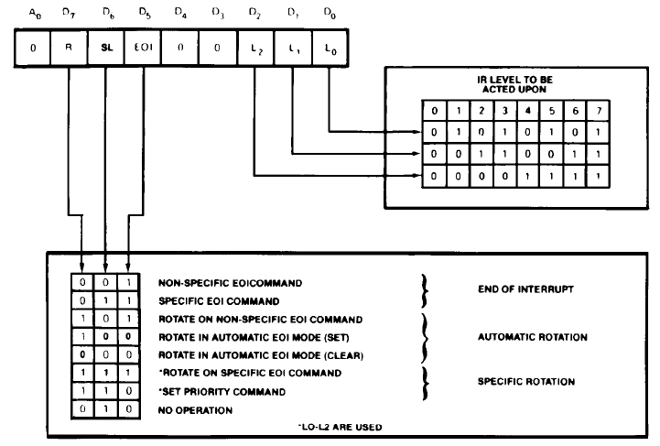
OCW2

Slide 4
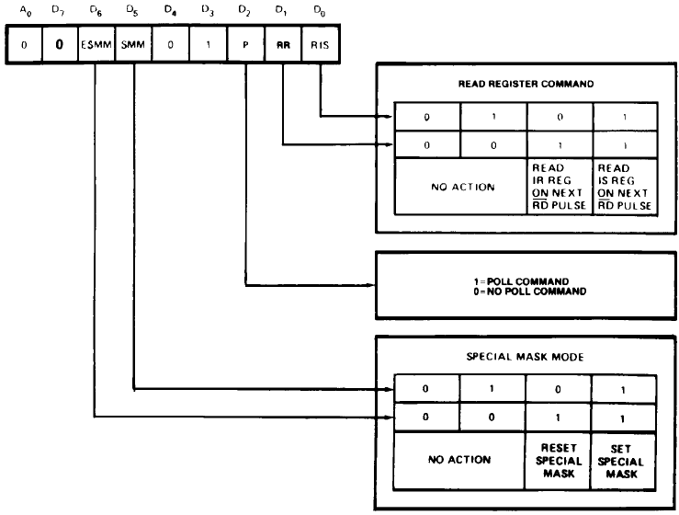
OCW3

Slide 5
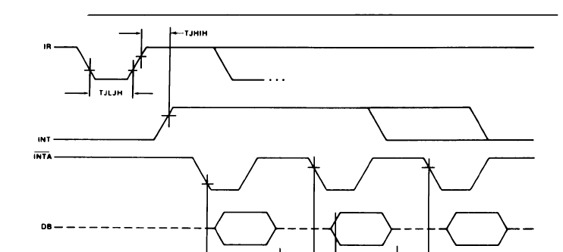
INTA waveform

Slide 6
Address Decoding for the Peripherals
Buffer
D0-D7
8255A
PPI
8086
Latch (‘373)
A0
A1
A2
A3
A4
A5
A6
A7
Y0
Y1
Y2
Y3
Y4
Y5
Y6
Y7
A0
A1
ACK_A
STB_A
AD0-AD7
X0
X1
X2
Decoder
CS
8259
ALE
A0
IR0
IR1
PPI Address: 011XXPP0
8259 Address: 101XXXP0
CS

Slide 7
Port Addresses
PORTA EQU 01100000b
PORTB EQU 01100010b
PORTC EQU 01100100b
PPICOM EQU 01100110b
P8259_0 EQU 10100000b
P8259_1 EQU 10100010b
PPI Address: 011XXPP0
8259 Address: 101XXXP0

Slide 8
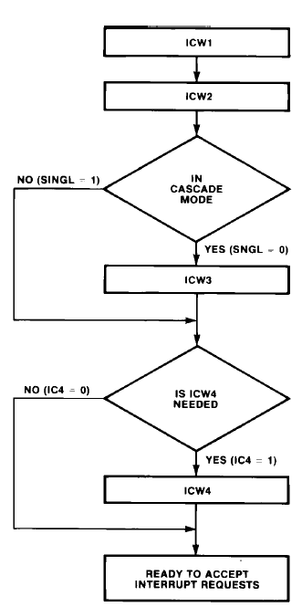
PIC Initializing Sequences

Slide 9
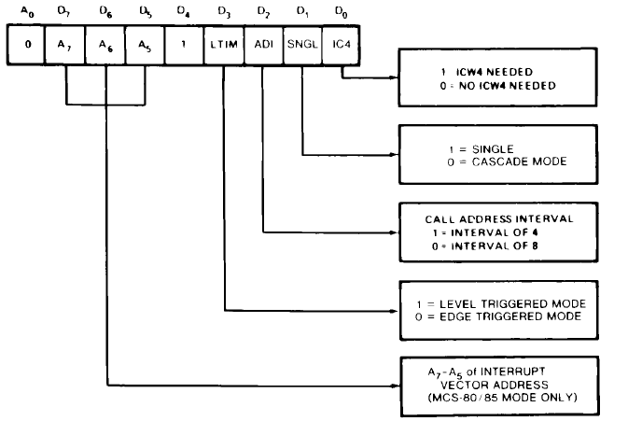
ICW1
MOV AL , 00010011b ;Edge – Single – ICW4
OUT P8259_0 , AL

Slide 10
ICW2
MOV AL , 80H ; Interrupt Type
OUT P8259_1 , AL
Addresses would be: 80H to 87H

Slide 11
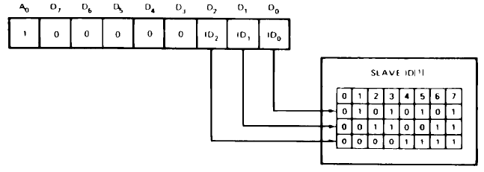
ICW3
Master Mode
Slave Mode
Is not needed in Single Mode

Slide 12
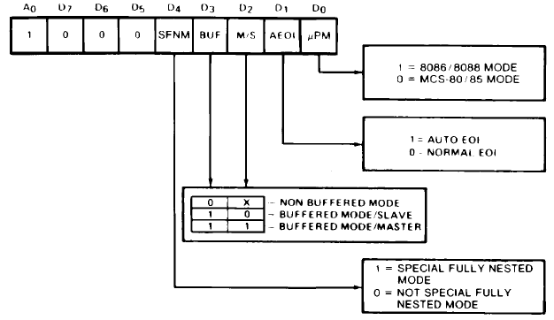
ICW4
MOV AL , 00000001b ; 8086 CPU
OUT P8259_1 , AL

Slide 13
OCW1
MOV AL , 11111100b ; Mask IR2 to IR7
OUT P8259_1 , AL

Slide 14
Initialize 8259
INIT_8259:
MOV AL , 00010011b ;Edge – Single – ICW4
OUT P8259_0 , AL
MOV AL , 80H ; Interrupt Type
OUT P8259_1 , AL
MOV AL , 00000001b ; 8086 CPU
OUT P8259_1 , AL
MOV AL , 11111100b ; Mask IR2 to IR7
OUT P8259_1 , AL
RET

Slide 15
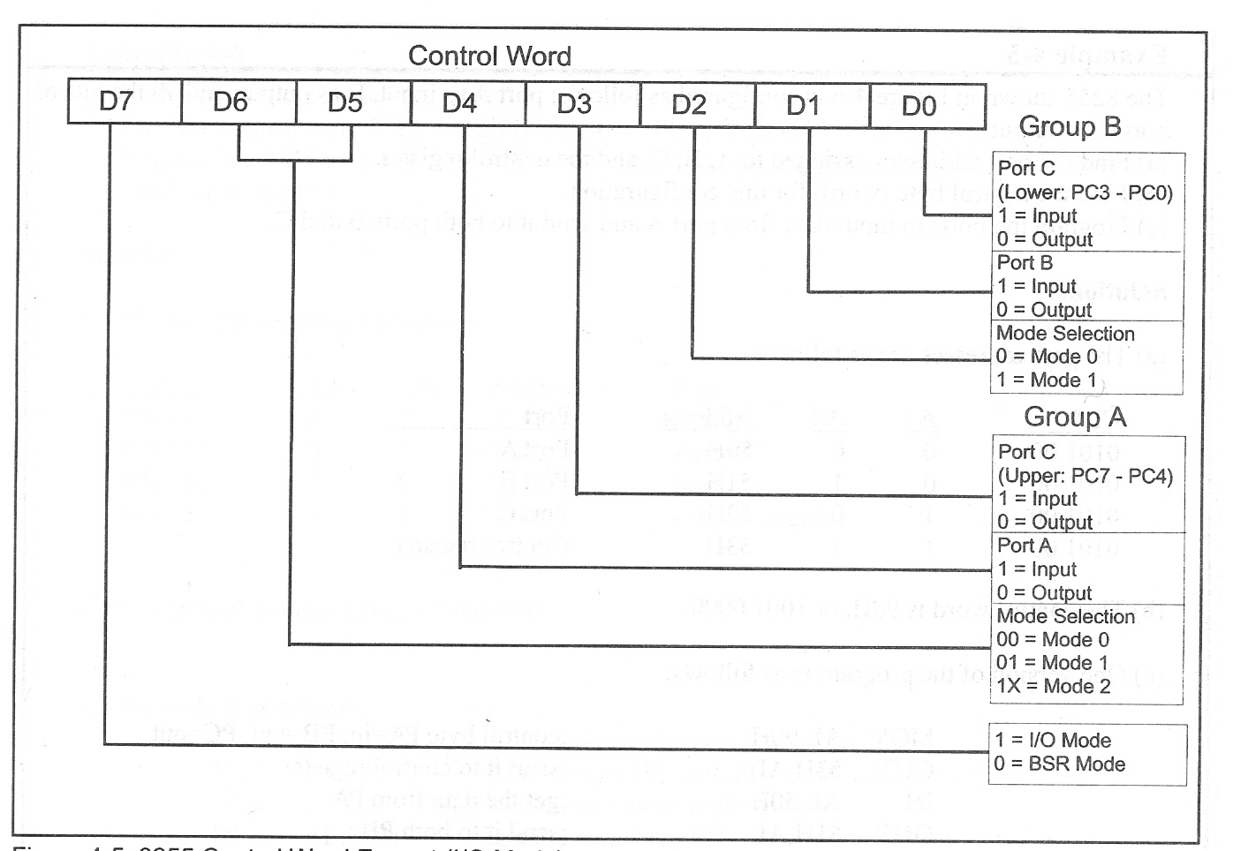
Initializing PPI
INIT_PPI:
MOV AL , 40H ;01XXXXXX Selecting Mode 2
OUT PPICOM , AL
MOV AL,1
MOV [TX_FLAG] , AL ; Flag Indicating Empty Buffer
XOR AL , AL
MOV [RX_FLAG] , AL ; Flag Indicating Empty Buffer
MOV [TX_head],AL
MOV [RX_head],AL
MOV [TX_tail],AL
MOV [RX_tail],AL
RET

Slide 16
OCW2
MOV AL,01100000b ;OCW2 (EOI for IR0)
OUT P8259_0,AL

Slide 17
Transmit Interrupt
INT_TX:
PUSH AX
PUSH BX
CALL TX_AVAIL_SIZE
JNZ CONT_TX
MOV AL,1
MOV [TX_FLAG],AL
JMP STOP_TX
CONT_TX:
MOV BX,TX_BUF
MOV BL,[TX_tail]
MOV AL,[BX]
OUT PORTA,AL
INC BL
MOV [TX_tail],BL
STOP_TX:
MOV AL,01100000b ;OCW2 (EOI for IR0)
OUT P8259_0,AL
POP BX
POP AX
IRET

Slide 18
Receive Interrupt
INT_RX:
PUSH AX
PUSH BX
CALL RX_EMPTY_SIZE
JNZ CONT_RX
MOV AL,1
MOV [RX_FLAG]
JMP STOP_RX
CONT-RX:
IN AL,PORTA
MOV BX,RX_BUF
MOV BL,[RX_head]
MOV [BX],AL
INC BL
MOV [RX_head],BL
STOP_RX:
MOV AL,01100001b ;OCW2 (EOI for IR1)
OUT P8259_0,AL
POP BX
POP AX
IRET

Slide 19
Set Interrupt Vectors
MOV AX,CS
MOV BX,INT_TX
MOV [4*80H],BX
MOV [4*80H+2],AX
MOV BX,INT_RX
MOV [4*81H],BX
MOV [4*81H+2],AX
200H
INT_TX:LOW
201H
INT_TX:HIGH
202H
CS:LOW
203H
CS:HIGH
INT_RX:LOW
204H
INT_RX:HIGH
205H
206H
CS:LOW
CS:HIGH
207H

Slide 20
Transmit Function
Transmit: ;Addr in SI, Size in CX
CALL TX_EMPTY_SIZE
JNZ CONT_Transmit
CALL Check_PPI_TX
CONT_Transmit:
MOV AL,[SI]
CALL PUTCHAR
INC SI
LOOP Transmit
CALL Check_PPI_TX
RET

Slide 21
Checking PPI for Transmit
Check_PPI_TX:
MOV AL,[TX_FLAG] ;Check if PPI Empty for TX
AND AL,AL
RETZ
MOV AL,[TX_FLAG] ;Check again.
AND AL,AL
RETZ
CALL TX_AVAIL_SIZE
RETZ
MOV BX,TX_BUF
MOV BL,[TX_tail]
MOV AL,[BX]
OUT PORTA,AL
INC BL
MOV [TX_tail],BL
XOR AL,AL
MOV [TX_FLAG],AL
RET

Slide 22
Receive Data
GETCH: ;Wait Until a char is received
CALL RX_AVAIL_SIZE
JNZ GETCHAR
CALL Check_PPI_RX
JMP GETCH

Slide 23
Checking input Buffer
Check_PPI_RX:
MOV AL,[RX_FLAG] ;Check if PPI Empty for TX
AND AL,AL
RETZ
MOV AL,[RX_FLAG] ;Check again.
AND AL,AL
RETZ
CALL RX_EMPTY_SIZE
RETZ
IN AL,PORTA
MOV BX,RX_BUF
MOV BL,[RX_head]
MOV [BX],AL
INC BL
MOV [RX_head],BL
XOR AL,AL
MOV [RX_FLAG],AL
RET

Slide 24
Data Storage Policy
Transmit
TX_Service
TX_FIFO
Process
PPI
RX_FIFO
Receive
RX_Service

Slide 25
Initializing PPI
INIT_PPI:
MOV AL , 40H ;01XXXXXX Selecting Mode 2
OUT PPICOM , AL
MOV AL,1
MOV [TX_FLAG] , AL ; Flag Indicating Empty Buffer
XOR AL , AL
MOV [RX_FLAG] , AL ; Flag Indicating Empty Buffer
MOV [TX_head],AL
MOV [RX_head],AL
MOV [TX_tail],AL
MOV [RX_tail],AL
RET

Slide 26
Checking FIFO
TX_AVAIL_SIZE:
MOV AL,[TX_head]
MOV BL,[TX_tail]
SUB AL,BL
RET
TX_EMPTY_SIZE:
MOV AL,[TX_head]
MOV BL,[TX_tail]
SUB AL,BL
NOT AL
RET
RX_AVAIL_SIZE:
MOV AL,[RX_head]
MOV BL,[RX_tail]
SUB AL,BL
RET
RX_EMPTY_SIZE:
MOV AL,[RX_head]
MOV BL,[RX_tail]
SUB AL,BL
NOT AL
RET

