Slide 1
Interrupt Controller
Introduction to 8259

Slide 2
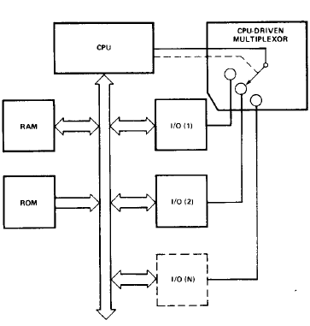
Poll Method

Slide 3
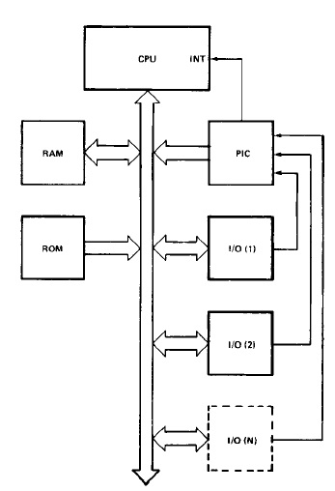
Interrupt Method

Slide 4
Features of 8259
8086, 8088 Compatible
MCS-80, MCS-85 Compatible
Eight-Level Priority Controller
Expandable to 64 Levels
Programmable Interrupt Modes
Individual Request Mask Capability
NMOS Tech. and Single +5V Supply (No Clocks)
Available in 28-Pin DIP and 28-Lead PLCC Package
Available in EXPRESS
Standard Temperature Range
Extended Temperature Range

Slide 5
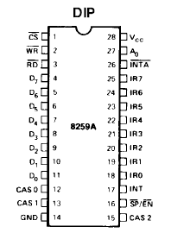
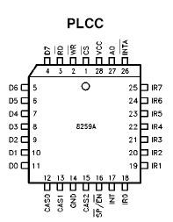
Packaging
Pins:
D0-D7
RD_
WR_
CS_
A0
INTA_
IR0 – IR7
INT
SP_/CN_
CAS0 – CAS2
Vcc
GND

Slide 6
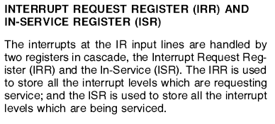
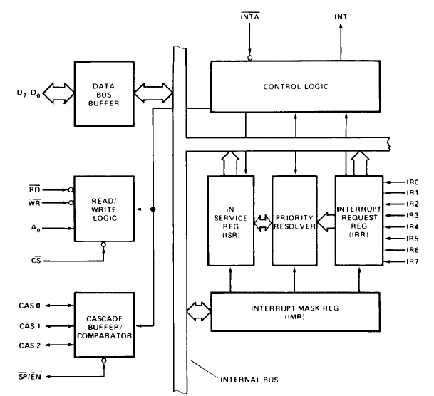
Block Diagram

Slide 7
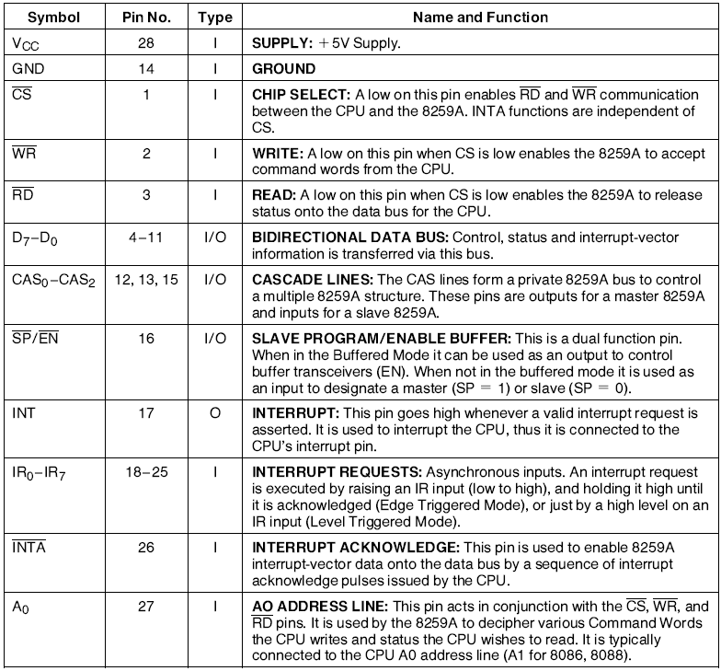
Pin Description

Slide 8
Interrupt Sequences
One or more of the INTERRUPT REQUEST lines (IR7±0) are raised high, setting the corresponding IRR bit(s).
The 8259A evaluates these requests, and sends an INT to the CPU, if appropriate.
The CPU acknowledges the INT and responds with an INTA pulse.
Upon receiving an INTA from the CPU group, the highest priority ISR bit is set and the corresponding IRR bit is reset. The 8259A does not drive the Data Bus during this cycle.
The 8086 will initiate a second INTA pulse. During this pulse, the 8259A releases an 8-bit pointer onto the Data Bus where it is read by the CPU.
This completes the interrupt cycle. In the AEOI mode the ISR bit is reset at the end of the second INTA pulse. Otherwise, the ISR bit remains set until an appropriate EOI command is issued at the end of the interrupt subroutine.

Slide 9
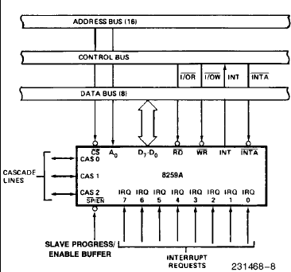
Interfacing to the CPU

Slide 10
PROGRAMMING THE 8259A
The 8259A accepts two types of command words generated by the CPU:
Initialization Command Words (ICWs): Before normal operation can begin, each 8259A in the system must be brought to a starting point by a sequence of 2 to 4 bytes timed by WR pulses.
Operation Command Words (OCWs): These are the command words which command the 8259A to operate in various interrupt modes. These modes are:
Fully nested mode
Rotating priority mode
Special mask mode
Polled mode
The OCWs can be written into the 8259A anytime after initialization.

Slide 11
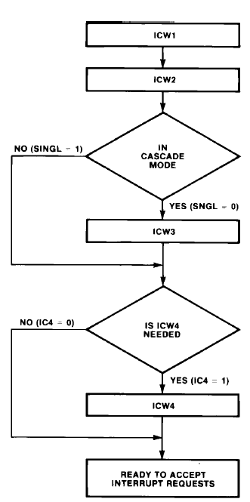
Initializing Sequences

Slide 12
Reset State
Whenever a command is issued with A0 = 0 and D4 = 1, this is interpreted as Initialization Command Word 1 (ICW1). ICW1 starts the initialization sequence during which the following automatically occur.
The edge sense circuit is reset, which means that following initialization, an interrupt request (IR) input must make a low-to-high transition to generate an interrupt.
The Interrupt Mask Register is cleared.
IR7 input is assigned priority 7.
The slave mode address is set to 7.
Special Mask Mode is cleared and Status Read is set to IRR.
If IC4 = 0, then all functions selected in ICW4 are set to zero. (Non-Buffered mode*, no Auto- EOI, MCS-80, 85 system).

Slide 13
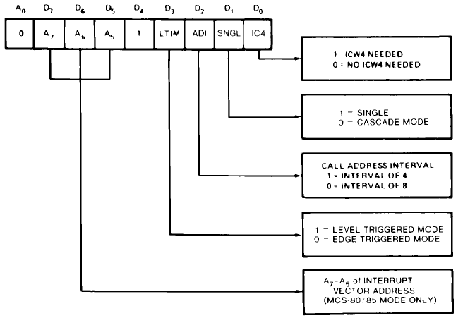
ICW1

Slide 14
ICW2

Slide 15
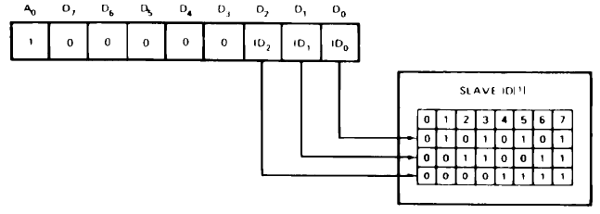
ICW3
Master Mode
Slave Mode

Slide 16
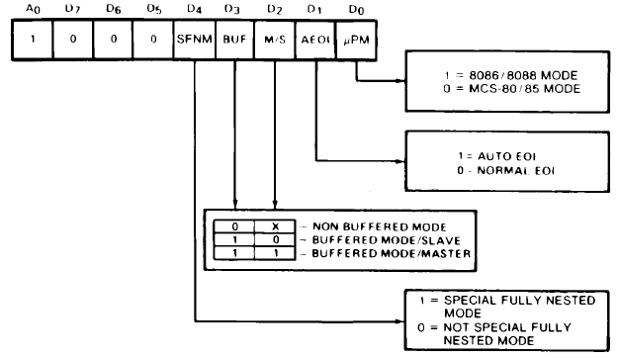
ICW4

Slide 17
OCW1

Slide 18
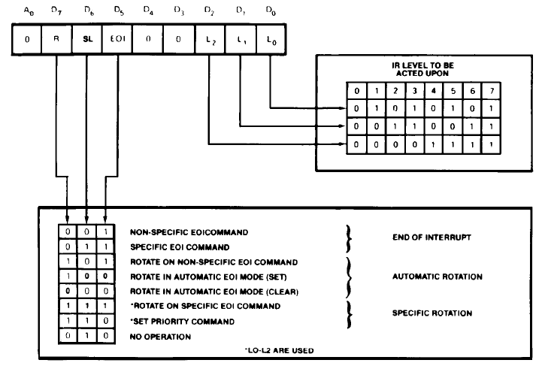
OCW2

Slide 19
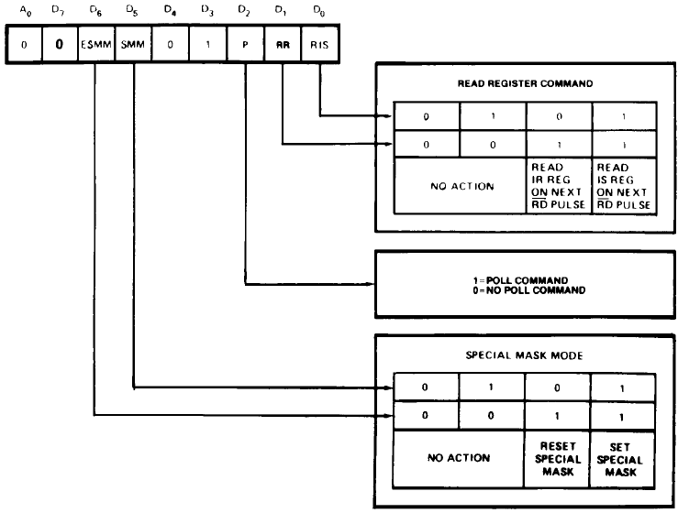
OCW3

Slide 20
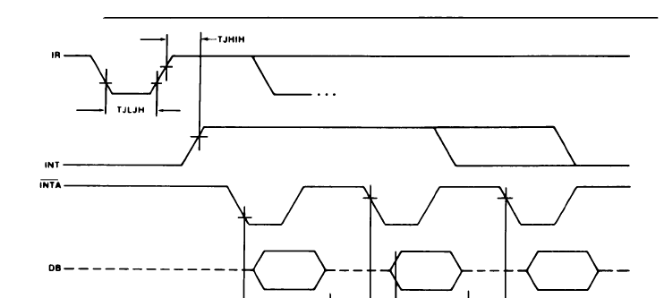
INTA waveform

Slide 21
Data Storage Policy
Transmit
TX_Service
TX_FIFO
Process
PPI
RX_FIFO
Receive
RX_Service

Slide 22
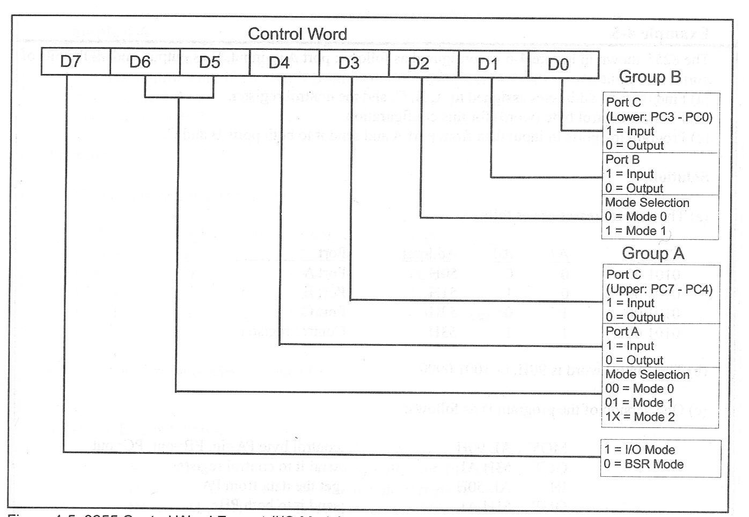
Initializing PPI
INIT_PPI:
MOV AL , 40H ;01XXXXXX Selecting Mode 2
OUT PPICOM , AL
MOV AL,1
MOV [TX_FLAG] , AL ; Flag Indicating Empty Buffer
XOR AL , AL
MOV [RX_FLAG] , AL ; Flag Indicating Empty Buffer
MOV [TX_head],AL
MOV [RX_head],AL
MOV [TX_tail],AL
MOV [RX_tail],AL
RET

Slide 23
Checking FIFO
TX_AVAIL_SIZE:
MOV AL,[TX_head]
MOV BL,[TX_tail]
SUB AL,BL
RET
TX_EMPTY_SIZE:
MOV AL,[TX_head]
MOV BL,[TX_tail]
SUB AL,BL
NOT AL
RET
RX_AVAIL_SIZE:
MOV AL,[RX_head]
MOV BL,[RX_tail]
SUB AL,BL
RET
RX_EMPTY_SIZE:
MOV AL,[RX_head]
MOV BL,[RX_tail]
SUB AL,BL
NOT AL
RET

