Slide 1
A Design Example
The Exact Calculator Software

Slide 2
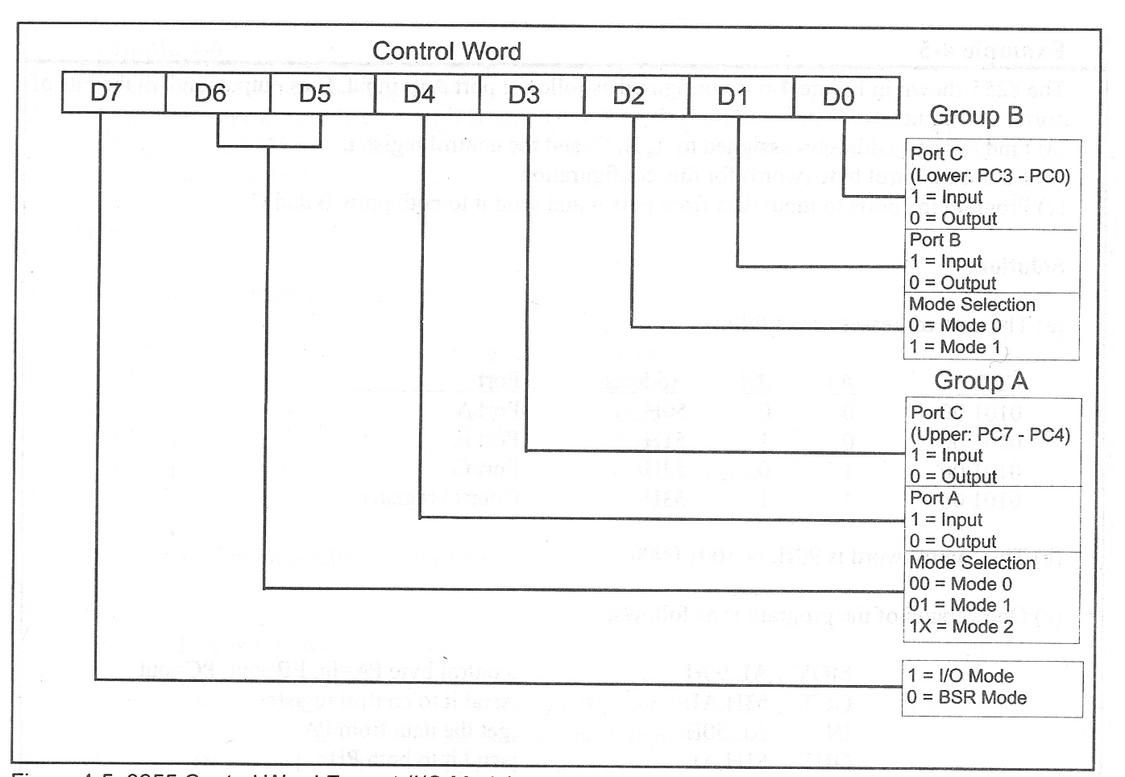
Control Word For Display
1 0 0 0 1 0 0 1 = 89H

Slide 3
INIT_DISPLAY
INIT_DISPLAY:
MOV AL,10001001B ;Mode 0 and out for both A & B. C input
OUT DISPLAY_CTRL,AL
MOV AL,0FFH
OUT DISPLAY_GND,AL ;All 7-Segments off
XOR AX,AX ;Clear ALL Ms of Calc(X,Y,M0-M7)
MOV ES,AX
MOV DI,offset X_SIZE
CLD
MOV CX,10
REP:STOSW ;X_SIZE=Y_SIZE=M_SIZE0-7=0
CALL REFRESH_DISPLAY
RET

Slide 4
REFRESH_DISPLAY
REFRESH_DISPLAY: ; Shows the content of X register
MOV DI,offset DISPLAY_DATA
MOV AX,[X_SIZE]
CMP AX,0
JNE X_NOT_ZERO
XOR AX,AX
MOV WORD PTR [DI],AX
MOV WORD PTR [DI+2],AX
MOV WORD PTR [DI+4],AX
MOV BYTE PTR [DI+6],AL
MOV BYTE PTR [DI+7],10111111B
RET

Slide 5
X_NOT_ZERO
X_NOT_ZERO:
CMP AX,8
JNAE X_LESS_THAN_8
MOV CX,8
MOV SI,offset X_VALUE
ADD SI,WORD PTR [DISPLAY_START]
MOV BX,offset ASCII_SEGMENTS
JMP FILL_DISPLAY
X_LESS_THAN_8:

Slide 6
X_LESS_THAN_8
X_LESS_THAN_8:
MOV CX,8
SUB CX,AX
XOR AL,AL
FILL_BLANK:
MOV [DI],AL
INC DI
LOOP FILL_BLANK
MOV SI,offset X_VALUE
MOV BX,offset ASCII_SEGMENTS
MOV CX,[X_SIZE]
FILL_DISPLAY:

Slide 7
FILL_DISPLAY
FILL_DISPLAY:
MOV AL,[SI]
AND AL,01111111B
XLATB
MOV AH,[SI] ;Point Inclusion
AND AH,10000000B
OR AL,AH
MOV [DI],AL
INC SI
INC DI
LOOP FILL_DISPLAY
RET

Slide 8
SCAN_DISPLAY
SCAN_DISPLAY:
MOV AL,0FFH
OUT DISPLAY_GND,AL ; All segments Off
MOV BX,offset DISPLAY_DATA
MOV BL,[DISPLAY_Counter]
MOV AL,[BX]
OUT DISPLAY_SEGMENTS,AL
MOV AL,[GND_DRIVER]
OUT DISPLAY_GND,AL ; Apropriate segment is on
ROR AL,1
MOV [GND_DRIVER],AL
INC BL
AND BL,7 ;Counter should be from 0 to 7
MOV [DISPLAY_Counter],BL
RET

Slide 9
GETCH
GETCH:
MOV BX,offset KEY_BUFF
MOV BL,[KEY_tail]
wait_for_key:
MOV AL,[Key_head]
CMP AL,BL
JE Wait_for_key
MOV AL,[BX]
INC BL
MOV [Key_tail],BL
RET

Slide 10
Process_key
Process_key:
MOV BX,offset Function_Table
SUB AL,32
ROL AL,1 ;AL=AL*2
MOV AH,0
ADD BX,AX
MOV BX,[BX]
JMP [BX]
Main_LOOP:
CALL GETCH
CALL Process_Key
JMP Main_LOOP

Slide 11
Function_Table
Function_Table:
DW offset SPACE_PROCESS
DW offset NOT_PROCESS
DW offset RIGHT_ARROW_PROCESS
DW offset PAGE_RIGHT_PROCESS
DW offset END_OF_RIGHT_PROCESS
DW offset PERCENT_PROCESS
DW offset AND_PROCESS
DW offset LEFT_ARROW_PROCESS ;39
DW offset PAGE_LEFT_PROCESS
DW offset END_OF_LEFT_PROCESS
DW offset STAR_PROCESS
DW offset PLUS_PROCESS ;43
DW offset TOMEMORY_PROCESS
DW offset RECALLMEMORY_PROCESS
DW offset PERIOD_PROCESS
DW offset DIVISION_PROCESS
DW offset ZERO_PROCESS
DW offset ONE_PROCESS
DW offset TWO_PROCESS
DW offset THREE_PROCESS
DW offset FOUR_PROCESS
DW offset FIVE_PROCESS
DW offset SIX_PROCESS
DW offset SEVEN_PROCESS
DW offset EIGHT_PROCESS
DW offset NINE_PROCESS
DW offset LOGICALOR_PROCESS ;58
DW offset POWER_PROCESS
DW offset BiggestDivisor_PROCESS
DW offset EQU_PROCESS
DW offset SmallestDivisor_PROCESS
DW offset Factorial_PROCESS
DW offset CLEAR_PROCESS
DW offset A_PROCESS
DW offset B_PROCESS
DW offset C_PROCESS
DW offset D_PROCESS
DW offset E_PROCESS
DW offset F_PROCESS
DW offset G_PROCESS
DW offset H_PROCESS
DW offset I_PROCESS
DW offset J_PROCESS
DW offset K_PROCESS
DW offset L_PROCESS
DW offset M_PROCESS
DW offset N_PROCESS
DW offset O_PROCESS
DW offset P_PROCESS
DW offset Q_PROCESS
DW offset R_PROCESS
DW offset S_PROCESS
DW offset T_PROCESS
DW offset U_PROCESS
DW offset V_PROCESS
DW offset W_PROCESS
DW offset X_PROCESS
DW offset Y_PROCESS
DW offset Z_PROCESS
DW offset CLEARALL_PROCESS
DW offset TIME_PROCESS
DW offset CHANGE_TIME_PROCESS
DW offset XOR_PROCESS
DW offset UNDERSCORE_PROCESS

Slide 12
ASCII_SEGMENTS
ASCII_SEGMENTS:
ASCII_0 DB 32 DUP(0)
SPACE DB 16 DUP(0)
ZERO DB 00111111B
ONE DB 00000110B
TWO DB 01011011B
THREE DB 01001111B
………………..

Slide 13
ZERO_PROCESS
ZERO_PROCESS:
MOV BX,[X_SIZE]
CMP BX,0
JNE ONE_PROCESS
RET

Slide 14
Digit Process
ONE_PROCESS:
TWO_PROCESS:
THREE_PROCESS:
FOUR_PROCESS:
FIVE_PROCESS:
SIX_PROCESS:
SEVEN_PROCESS:
EIGHT_PROCESS:
NINE_PROCESS:
MOV BX,[STATUS]
AND BX,X_EDIT
JZ NEW_NUMBER
MOV BX,[X_SIZE]
ADD BX,offset X_VALUE
MOV [BX],AL
MOV BX,[X_SIZE]
INC BX
MOV [X_SIZE],BX
RET
NEW_NUMBER:
MOV BX,[STATUS]
OR BX,X_EDIT
MOV [STATUS],BX
CMP AL,'0'
JNE POSITIVE
MOV [X_SIZE],0
RET
POSITIVE:
MOV [X_SIZE],1
RET

